Slide 1
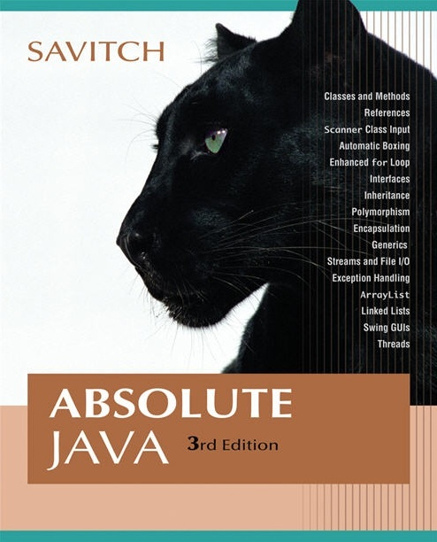


Chapter 6
Arrays
Copyright © 2008 Pearson Addison-Wesley. All rights reserved

Slide 2
Introduction to Arrays
An array is a data structure used to process a collection of data that is all of the same type
  An array behaves like a numbered list of variables with a uniform naming mechanism
  It has a part that does not change: the name of the array
  It has a part that can change: an integer in square brackets
  For example, given five scores:
score[0], score[1], score[2], score[3], score[4]
Copyright © 2008 Pearson Addison-Wesley. All rights reserved
6-<number>

Slide 3
Creating and Accessing Arrays
An array that behaves like this collection of variables, all of type double, can be created using one statement as follows:
  double[] score = new double[5];
Or using two statements:
  double[] score;
  score = new double[5];
  The first statement declares the variable score to be of the array type double[]
  The second statement creates an array with five numbered variables of type double and makes the variable score a name for the array
Copyright © 2008 Pearson Addison-Wesley. All rights reserved
6-<number>

Slide 4
Creating and Accessing Arrays
The individual variables that together make up the array are called indexed variables
  They can also be called subscripted variables or elements of the array
  The number in square brackets is called an index or subscript
  In Java, indices must be numbered starting with 0, and nothing else
score[0], score[1], score[2], score[3], score[4]
Copyright © 2008 Pearson Addison-Wesley. All rights reserved
6-<number>

Slide 5
Creating and Accessing Arrays
The number of indexed variables in an array is called the length or size of the array
When an array is created, the length of the array is given in square brackets after the array type
The indexed variables are then numbered starting with 0, and ending with the integer that is one less than the length of the array
score[0], score[1], score[2], score[3], score[4]
Copyright © 2008 Pearson Addison-Wesley. All rights reserved
6-<number>

Slide 6
Creating and Accessing Arrays
  double[] score = new double[5];
A variable may be used in place of the integer (i.e., in place of the integer 5 above)
  The value of this variable can then be read from the keyboard
  This enables the size of the array to be determined when the program is run
  double[] score = new double[count];
An array can have indexed variables of any type, including any class type
All of the indexed variables in a single array must be of the same type, called the base type of the array
Copyright © 2008 Pearson Addison-Wesley. All rights reserved
6-<number>

Slide 7
Declaring and Creating an Array
An array is declared and created in almost the same way that objects are declared and created:
BaseType[] ArrayName = new BaseType[size];
  The size may be given as an expression that evaluates to a nonnegative integer, for example, an int variable
    char[] line = new char[80];
    double[] reading = new double[count];
    Person[] specimen = new Person[100];
Copyright © 2008 Pearson Addison-Wesley. All rights reserved
6-<number>

Slide 8
Referring to Arrays and Array Elements
Each array element can be used just like any other single variable by referring to it using an indexed expression: score[0]
The array itself (i.e., the entire collection of indexed variables) can be referred to using the array name (without any square brackets): score
An array index can be computed when a program is run
  It may be represented by a variable: score[index]
  It may be represented by an expression that evaluates to a suitable integer: score[next + 1]
  Note: Demo ArrayOfScores
Copyright © 2008 Pearson Addison-Wesley. All rights reserved
6-<number>

Slide 9
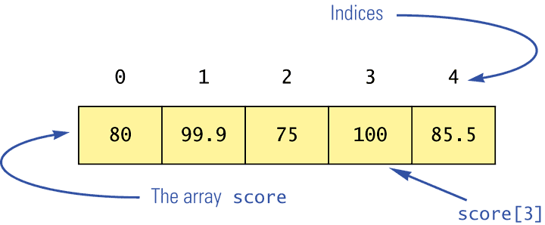
Using the score Array in a Program
The for loop is ideally suited for performing array manipulations:
  for (index = 0; index < 5; index++)
System.out.println(score[index] +
" differs from max by " +
(max-score[index]) );
Copyright © 2008 Pearson Addison-Wesley. All rights reserved
6-<number>

Slide 10
Three Ways to Use Square Brackets [] with an Array Name
Square brackets can be used to create a type name:
  double[] score;
Square brackets can be used with an integer value as part of the special syntax Java uses to create a new array:
  score = new double[5];
Square brackets can be used to name an indexed variable of an array:
  max = score[0];
Copyright © 2008 Pearson Addison-Wesley. All rights reserved
6-<number>

Slide 11
The length Instance Variable
An array is considered to be an object
Since other objects can have instance variables, so can arrays
Every array has exactly one instance variable named length
  When an array is created, the instance variable length is automatically set equal to its size
  The value of length cannot be changed (other than by creating an entirely new array with new)
    double[] score = new double[5];
  Given score above, score.length has a value of 5
  Note: See ArrayOfScores2 for the use of score.length
Copyright © 2008 Pearson Addison-Wesley. All rights reserved
6-<number>

Slide 12
Pitfall: Array Index Out of Bounds
Array indices always start with 0, and always end with the integer that is one less than the size of the array
  The most common programming error made when using arrays is attempting to use a nonexistent array index
When an index expression evaluates to some value other than those allowed by the array declaration, the index is said to be out of bounds
  An out of bounds index will cause a program to terminate with a run-time error message
  Array indices get out of bounds most commonly at the first or last iteration of a loop that processes the array: Be sure to test for this!
Copyright © 2008 Pearson Addison-Wesley. All rights reserved
6-<number>

Slide 13
Suppose we expect the elements of the array a to be ordered so that
a[0] ≤ a[1] ≤ a[2] ≤ ...
However, to be safe we want our program to test the array and issue
a warning in case it turns out that some elements are out of order.
The following code is supposed to output such a warning, but it
contains a bug; what is the bug?
double[] a = new double[10];
<some code to fill the array a goes here>
for ( int i = 0; i < a.length; i++ )
if ( a[i] > a[i + 1] )
System.out.println( “Array elements “ + i + “ and “ +
( i + 1 ) + “ are out of order.” );
6-<number>

Slide 14
Initializing Arrays
An array can be initialized when it is declared
  Values for the indexed variables are enclosed in braces, and separated by commas
  The array size is automatically set to the number of values in the braces
    int[] age = {2, 12, 1};
  Given age above, age.length has a value of 3
Copyright © 2008 Pearson Addison-Wesley. All rights reserved
6-<number>

Slide 15
Initializing Arrays
Another way of initializing an array is by using a for loop
  double[] reading = new double[100];
  int index;
  for (index = 0;
  index < reading.length; index++)
  reading[index] = 42.0;
If the elements of an array are not initialized explicitly, they will automatically be initialized to the default value for their base type
Copyright © 2008 Pearson Addison-Wesley. All rights reserved
6-<number>

Slide 16
Pitfall: An Array of Characters Is Not a String
An array of characters is conceptually a list of characters, and so is conceptually like a string
However, an array of characters is not an object of the class String
  char[] a = {'A', 'B', 'C'};
  String s = a; //Illegal!
An array of characters can be converted to an object of type String, however
Copyright © 2008 Pearson Addison-Wesley. All rights reserved
6-<number>

Slide 17
Pitfall: An Array of Characters Is Not a String
The class String has a constructor that has a single parameter of type char[]
  String s = new String(a);
  The object s will have the same sequence of characters as the entire array a ("ABC"), but is an independent copy
Another String constructor uses a subrange of a character array instead
  String s2 = new String(a,0,2);
  Given a as before, the new string object is "AB"
Copyright © 2008 Pearson Addison-Wesley. All rights reserved
6-<number>

Slide 18
Pitfall: An Array of Characters Is Not a String
An array of characters does have some things in common with String objects
  For example, an array of characters can be output using println
    System.out.println(a);
  Given a as before, this would produce the output
    ABC
Copyright © 2008 Pearson Addison-Wesley. All rights reserved
6-<number>

Slide 19
Arrays and References
Like class types, a variable of an array type holds a reference
  Arrays are objects
  A variable of an array type holds the address of where the array object is stored in memory
  Array types are (usually) considered to be class types
Copyright © 2008 Pearson Addison-Wesley. All rights reserved
6-<number>

Slide 20
Arrays are Objects
An array can be viewed as a collection of indexed variables
An array can also be viewed as a single item whose value is a collection of values of a base type
  An array variable names the array as a single item
    double[] a;
  A new expression creates an array object and stores the object in memory
    new double[10]
  An assignment statement places a reference to the memory address of an array object in the array variable
    a = new double[10];
Copyright © 2008 Pearson Addison-Wesley. All rights reserved
6-<number>

Slide 21
Arrays Are Objects
The previous steps can be combined into one statement
  double[] a = new double[10];
Note that the new expression that creates an array invokes a constructor that uses a nonstandard syntax
Not also that as a result of the assignment statement above, a contains a single value: a memory address or reference
Since an array is a reference type, the behavior of arrays with respect to assignment (=), equality testing (==), and parameter passing are the same as that described for classes
Copyright © 2008 Pearson Addison-Wesley. All rights reserved
6-<number>

Slide 22
Pitfall: Arrays with a Class Base Type
The base type of an array can be a class type
  Date[] holidayList = new Date[20];
The above example creates 20 indexed variables of type Date
  It does not create 20 objects of the class Date
  Each of these indexed variables are automatically initialized to null
  Any attempt to reference any them at this point would result in a "null pointer exception" error message
Copyright © 2008 Pearson Addison-Wesley. All rights reserved
6-<number>

Slide 23
Pitfall: Arrays with a Class Base Type
Like any other object, each of the indexed variables requires a separate invocation of a constructor using new (singly, or perhaps using a for loop) to create an object to reference
  holidayList[0] = new Date();
  . . .
  holidayList[19] = new Date();
  OR
  for (int i = 0; i < holidayList.length; i++)
  holidayList[i] = new Date();
Each of the indexed variables can now be referenced since each holds the memory address of a Date object
Copyright © 2008 Pearson Addison-Wesley. All rights reserved
6-<number>

Slide 24
Array Parameters
Both array indexed variables and entire arrays can be used as arguments to methods
  An indexed variable can be an argument to a method in exactly the same way that any variable of the array base type can be an argument
Copyright © 2008 Pearson Addison-Wesley. All rights reserved
6-<number>

Slide 25
Array Parameters
  double n = 0.0;
  double[] a = new double[10];//all elements
  //are initialized to 0.0
  int i = 3;
Given myMethod which takes one argument of type double, then all of the following are legal:
  myMethod(n);//n evaluates to 0.0
  myMethod(a[3]);//a[3] evaluates to 0.0
  myMethod(a[i]);//i evaluates to 3,
  //a[3] evaluates to 0.0
Copyright © 2008 Pearson Addison-Wesley. All rights reserved
6-<number>

Slide 26
Array Parameters
An argument to a method may be an entire array
Array arguments behave like objects of a class
  Therefore, a method can change the values stored in the indexed variables of an array argument
A method with an array parameter must specify the base type of the array only
    BaseType[]
  It does not specify the length of the array
Copyright © 2008 Pearson Addison-Wesley. All rights reserved
6-<number>

Slide 27
Array Parameters
The following method, doubleElements, specifies an array of double as its single argument:
public class SampleClass
{
public static void doubleElements(double[] a)
{
int i;
for (i = 0; i < a.length; i++)
a[i] = a[i]*2;
. . .
}
. . .
}
Copyright © 2008 Pearson Addison-Wesley. All rights reserved
6-<number>

Slide 28
Array Parameters
Arrays of double may be defined as follows:
  double[] a = new double[10];
  double[] b = new double[30];
Given the arrays above, the method doubleElements from class SampleClass can be invoked as follows:
  SampleClass.doubleElements(a);
  SampleClass.doubleElements(b);
  Note that no square brackets are used when an entire array is given as an argument
  Note also that a method that specifies an array for a parameter can take an array of any length as an argument
Copyright © 2008 Pearson Addison-Wesley. All rights reserved
6-<number>

Slide 29
public class SampleClass {
public static void doubleElements(double[] a){
int i;
for (i = 0; i < a.length; i++)
a[i] = a[i]*2;
}
public static void main(String[] args) {
double[] score = {3.5, 2.5, 10};
double[] number = {100, 200, 45, 23.5, 35.8, 12, 56.9};
int index;
System.out.println(“Original score array:” );
for (index = 0; index < score.length; index++)
System.out.println(score[index] );
System.out.println(“Original number array:”);
for (index = 0; index < number.length; index++)
System.out.println(number[index] );
doubleElements (score);
doubleElements (number);
System.out.println(“new score array: “);
for (index = 0; index < score.length; index++)
System.out.println(score[index] );
System.out.println(“new number array: “);
for (index = 0; index < number.length; index++)
System.out.println(number[index] );
}//end main
}//end class
6-<number>

Slide 30
public class AClass
{
public static void listChars( char[] a )
{
int i;
for ( i = 0; i < a.length; i++; )
System.out.println( a[i] + “ “ );
}
public static void zeroAll( int[] anArray )
{
int i;
for ( i = 0; i < anArray.length; i++ )
anArray[i] = 0;
}
...
}
...
char[] c = new char[10];
int[] a = new int[10];
int[] b = new int[50];
...
AClass.listChars( c );
AClass.zeroAll( a );
AClass.zeroAll( b );
Notice that arrays a and b have different lengths
6-<number>

Slide 31
Pitfall: Use of = and == with Arrays
Because an array variable contains the memory address of the array it names, the assignment operator (=) only copies this memory address
  It does not copy the values of each indexed variable
  Using the assignment operator will make two array variables be different names for the same array
    b = a;
  The memory address in a is now the same as the memory address in b: They reference the same array
Copyright © 2008 Pearson Addison-Wesley. All rights reserved
6-<number>

Slide 32
Pitfall: Use of = and == with Arrays
A for loop is usually used to make two different arrays have the same values in each indexed position:
  int i;
  for (i = 0;
  (i < a.length) && (i < b.length); i++)
  b[i] = a[i];
  Note that the above code will not make b an exact copy of a, unless a and b have the same length
Copyright © 2008 Pearson Addison-Wesley. All rights reserved
6-<number>

Slide 33
Pitfall: Use of = and == with Arrays
For the same reason, the equality operator (==) only tests two arrays to see if they are stored in the same location in the computer's memory
  It does not test two arrays to see if they contain the same values
    (a == b)
  The result of the above boolean expression will be true if a and b share the same memory address (and, therefore, reference the same array), and false otherwise
Copyright © 2008 Pearson Addison-Wesley. All rights reserved
6-<number>

Slide 34
Pitfall: Use of = and == with Arrays
In the same way that an equals method can be defined for a class, an equalsArray method can be defined for a type of array
  This is how two arrays must be tested to see if they contain the same elements
  The following method tests two integer arrays to see if they contain the same integer values
Copyright © 2008 Pearson Addison-Wesley. All rights reserved
6-<number>

Slide 35
Pitfall: Use of = and == with Arrays
public static boolean equalsArray(int[] a, int[] b)
{
if (a.length != b.length) return false;
else
{
int i = 0;
while (i < a.length)
{
if (a[i] != b[i])
return false;
i++;
}
}
return true;
}
Copyright © 2008 Pearson Addison-Wesley. All rights reserved
6-<number>

Slide 36
DifferentEquals
6-<number>

Slide 37
Methods That Return an Array
In Java, a method may also return an array
  The return type is specified in the same way that an array parameter is specified
    public static int[]
    incrementArray(int[] a, int increment)
    {
    int[] temp = new int[a.length];
    int i;
    for (i = 0; i < a.length; i++)
    temp[i] = a[i] + increment;
    return temp;
    }
Copyright © 2008 Pearson Addison-Wesley. All rights reserved
6-<number>

Slide 38
public class SampleClass1 {
public static int[] incrementArray(int[] a, int increment){
int[] temp = new int[a.length];
int i;
for (i = 0; i < a.length; i++)
temp[i] = a[i] + increment;
return temp;
}
public static void main(String[] args) {
int[] score = {3, 2, 10};
int[] number = {100, 200, 45, 2, 35, 12, 56};
int index;
System.out.println(“Original score array:” );
for (index = 0; index < score.length; index++)
System.out.println(score[index] );
System.out.println(“Original number array:”);
for (index = 0; index < number.length; index++)
System.out.println(number[index] );
int[] newScore = incrementArray (score,10);
int[] newNumber=incrementArray (number,100);
System.out.println(“new score array: “);
for (index = 0; index < score.length; index++)
System.out.println(newScore[index] );
System.out.println(“new number array: “);
for (index = 0; index < number.length; index++)
System.out.println(newNumber[index] );
}//end main
}//end class
6-<number>

Slide 39
Partially Filled Arrays(**)
The exact size needed for an array is not always known when a program is written, or it may vary from one run of the program to another
A common way to handle this is to declare the array to be of the largest size that the program could possibly need
Care must then be taken to keep track of how much of the array is actually used
  An indexed variable that has not been given a meaningful value must never be referenced
Copyright © 2008 Pearson Addison-Wesley. All rights reserved
6-<number>

Slide 40
Partially Filled Arrays
A variable can be used to keep track of how many elements are currently stored in an array
  For example, given the variable count, the elements of the array someArray will range from positions someArray[0] through someArray[count – 1]
  Note that the variable count will be used to process the partially filled array instead of someArray.length
  Note also that this variable (count) must be an argument to any method that manipulates the partially filled array
Copyright © 2008 Pearson Addison-Wesley. All rights reserved
6-<number>

Slide 41
Partially Filled Arrays
Show program GolfScores (note the use of sentinel values)
Show class PartiallyFilledArray
Show program GolfScoresVersion2 (demo for PartiallyFilledArray)
6-<number>

Slide 42
Privacy Leaks with Array Instance Variables
If an accessor method does return the contents of an array, special care must be taken
  Just as when an accessor returns a reference to any private object
  public double[] getArray()
  {
  return anArray;//BAD!
  }
  The example above will result in a privacy leak
Copyright © 2008 Pearson Addison-Wesley. All rights reserved
6-<number>

Slide 43
Privacy Leaks with Array Instance Variables
The previous accessor method would simply return a reference to the array anArray itself
Instead, an accessor method should return a reference to a deep copy of the private array object
  Below, both a and count are instance variables of the class containing the getArray method
  public double[] getArray()
  {
  double[] temp = new double[count];
  for (int i = 0; i < count; i++)
  temp[i] = a[i];
  return temp
  }
Copyright © 2008 Pearson Addison-Wesley. All rights reserved
6-<number>

Slide 44
Privacy Leaks with Array Instance Variables
If a private instance variable is an array that has a class as its base type, then copies must be made of each class object in the array when the array is copied:
  public ClassType[] getArray()
  {
  ClassType[] temp = new ClassType[count];
  for (int i = 0; i < count; i++)
  temp[i] = new ClassType(someArray[i]);
  return temp;
  }
  Note: see ToyExample
Copyright © 2008 Pearson Addison-Wesley. All rights reserved
6-<number>

Slide 45
Sorting an Array
A sort method takes in an array parameter a, and rearranges the elements in a, so that after the method call is finished, the elements of a are sorted in ascending order
A selection sort accomplishes this by using the following algorithm:
  for (int index = 0; index < count; index++)
  Place the indexth smallest element in
  a[index]
Copyright © 2008 Pearson Addison-Wesley. All rights reserved
6-<number>

Slide 46
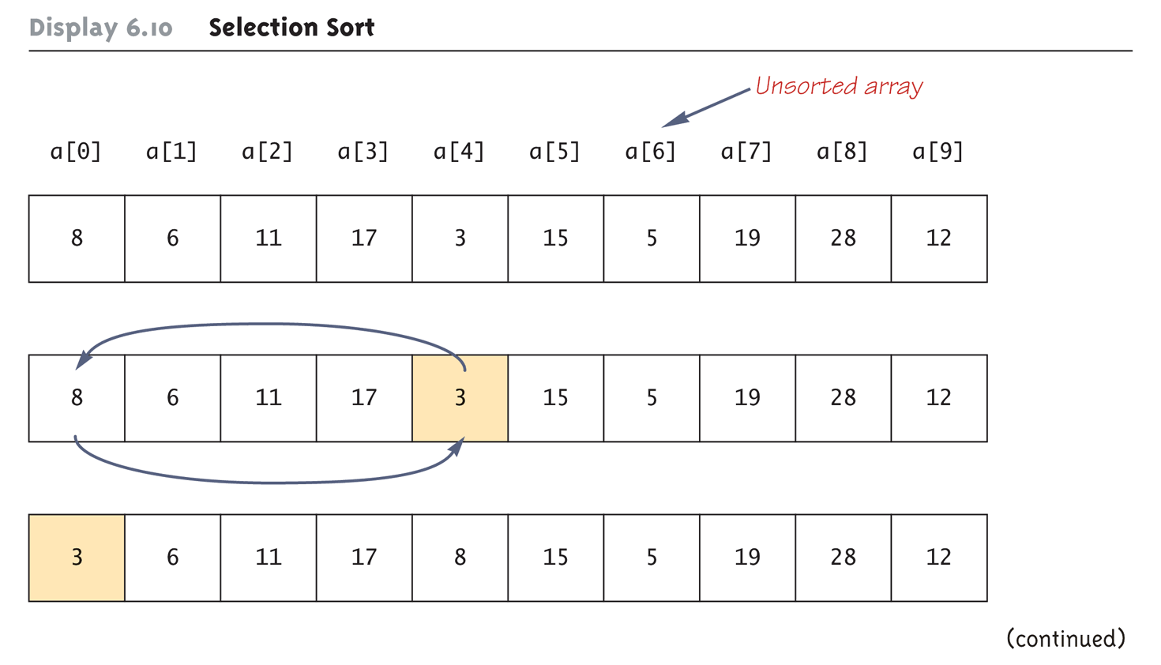
Selection Sort (Part 1 of 2)
Copyright © 2008 Pearson Addison-Wesley. All rights reserved
6-<number>

Slide 47
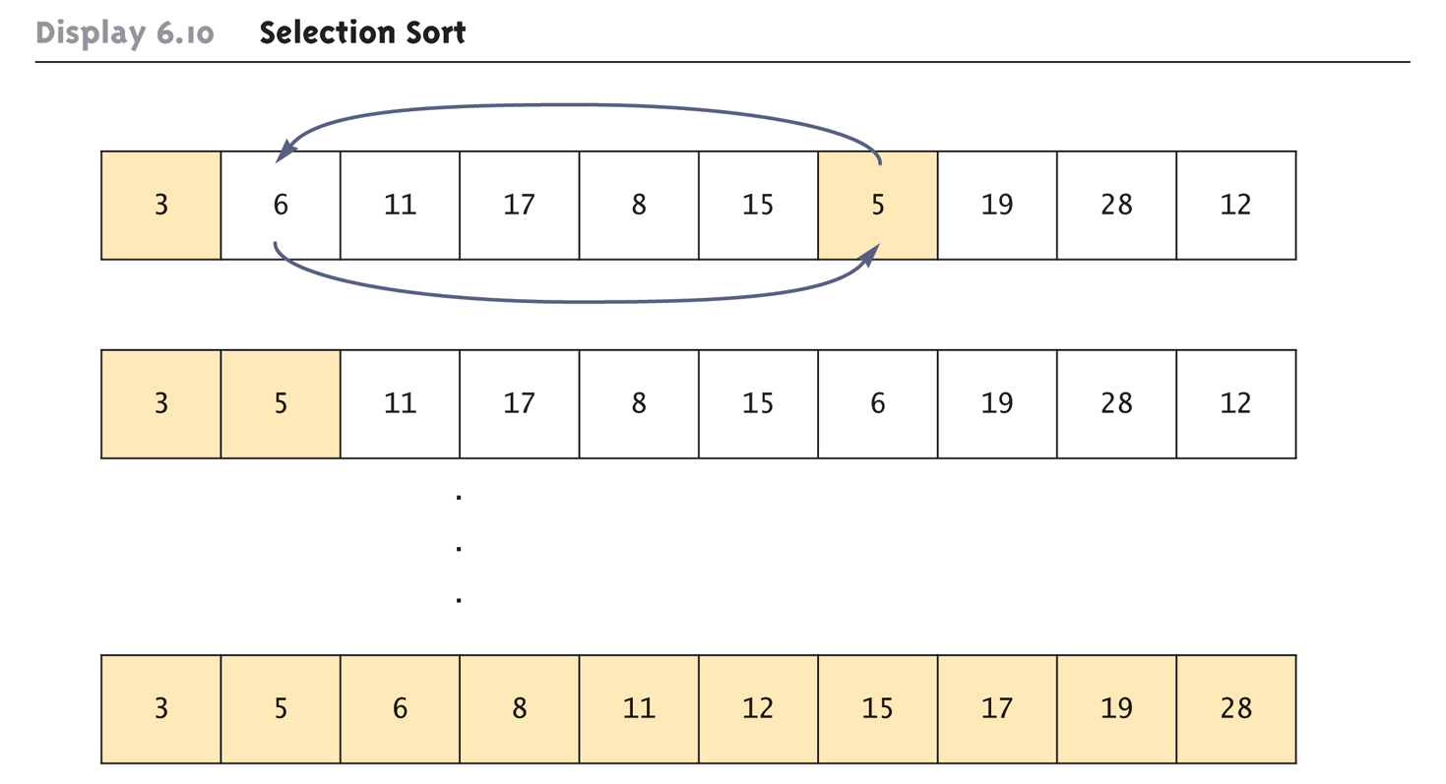
Selection Sort (Part 2 of 2)
Copyright © 2008 Pearson Addison-Wesley. All rights reserved
6-<number>

Slide 48
SelectionSort Class (Part 1 of 5)
public class SelectionSort
{
/**
Precondition: count <= a.length;
The first count indexed variables have
values.
Action: Sorts a so that a[0] <= a[1] <=
... <= a[count - 1].
*/
Copyright © 2008 Pearson Addison-Wesley. All rights reserved
6-<number>

Slide 49
SelectionSort Class (Part 2 of 5)
public static void sort(double[] a, int count)
{
int index, indexOfNextSmallest;
for (index = 0; index < count - 1; index++)
{
indexOfNextSmallest =
indexOfSmallest(index, a, count);
interchange(index, indexOfNextSmallest, a);
}
}
Copyright © 2008 Pearson Addison-Wesley. All rights reserved
6-<number>

Slide 50
SelectionSort Class (Part 3 of 5)
/**
Returns the index of the smallest value among
a[startIndex], a[startIndex+1], ... a[count - 1]
*/
private static int indexOfSmallest(int
startIndex, double[] a, int count)
{
double min = a[startIndex];
int indexOfMin = startIndex;
int index;
Copyright © 2008 Pearson Addison-Wesley. All rights reserved
6-<number>

Slide 51
SelectionSort Class (Part 4 of 5)
for (index = startIndex + 1;
index < count; index++)
if (a[index] < min)
{
min = a[index];
indexOfMin = index;
}
return indexOfMin;
}
Copyright © 2008 Pearson Addison-Wesley. All rights reserved
6-<number>

Slide 52
SelectionSort Class (Part 5 of 5)
/* Precondition: i and j are legal indices for
the array a.
Postcondition: Values of a[i] and a[j] have
been interchanged. */
private static void interchange(int i, int j,
double[] a)
{
double temp;
temp = a[i];
a[i] = a[j];
a[j] = temp; //original value of a[i]
}
}
Note: see SelectionSort and SelectionSortDemo
Copyright © 2008 Pearson Addison-Wesley. All rights reserved
6-<number>

Slide 53
Enumerated Types
Starting with version 5.0, Java permits enumerated types
  An enumerated type is a type in which all the values are given in a (typically) short list
The definition of an enumerated type is normally placed outside of all methods in the same place that named constants are defined:
  enum TypeName {VALUE_1, VALUE_2, …, VALUE_N};
  Note that a value of an enumerated type is a kind of named constant and so, by convention, is spelled with all uppercase letters
  As with any other type, variables can be declared of an enumerated type
Copyright © 2008 Pearson Addison-Wesley. All rights reserved
6-<number>

Slide 54
Enumerated Types Example
Given the following definition of an enumerated type:
  enum WorkDay {MONDAY, TUESDAY, WEDNESDAY, THURSDAY, FRIDAY};
A variable of this type can be declared as follows:
  WorkDay meetingDay, availableDay;
The value of a variable of this type can be set to one of the values listed in the definition of the type, or else to the special value null:
  meetingDay = WorkDay.THURSDAY;
  availableDay = null;
Copyright © 2008 Pearson Addison-Wesley. All rights reserved
6-<number>

Slide 55
Enumerated Types Usage
Just like other types, variable of this type can be declared and initialized at the same time:
  WorkDay meetingDay = WorkDay.THURSDAY;
  Note that the value of an enumerated type must be prefaced with the name of the type
The value of a variable or constant of an enumerated type can be output using println
  The code:
    System.out.println(meetingDay);
  Will produce the following output:
    THURSDAY
  As will the code:
    System.out.println(WorkDay.THURSDAY);
  Note that the type name WorkDay is not output
Copyright © 2008 Pearson Addison-Wesley. All rights reserved
6-<number>

Slide 56
Enumerated Types Usage
Although they may look like String values, values of an enumerated type are not String values
However, they can be used for tasks which could be done by String values and, in some cases, work better
  Using a String variable allows the possibility of setting the variable to a nonsense value
  Using an enumerated type variable constrains the possible values for that variable
  An error message will result if an attempt is made to give an enumerated type variable a value that is not defined for its type
Copyright © 2008 Pearson Addison-Wesley. All rights reserved
6-<number>

Slide 57
Enumerated Types Usage
Two variables or constants of an enumerated type can be compared using the equals method or the == operator
However, the == operator has a nicer syntax
  if (meetingDay == availableDay)
  System.out.println("Meeting will be on schedule.");
  if (meetingDay == WorkDay.THURSDAY)
  System.out.println("Long weekend!);
Copyright © 2008 Pearson Addison-Wesley. All rights reserved
6-<number>

Slide 58
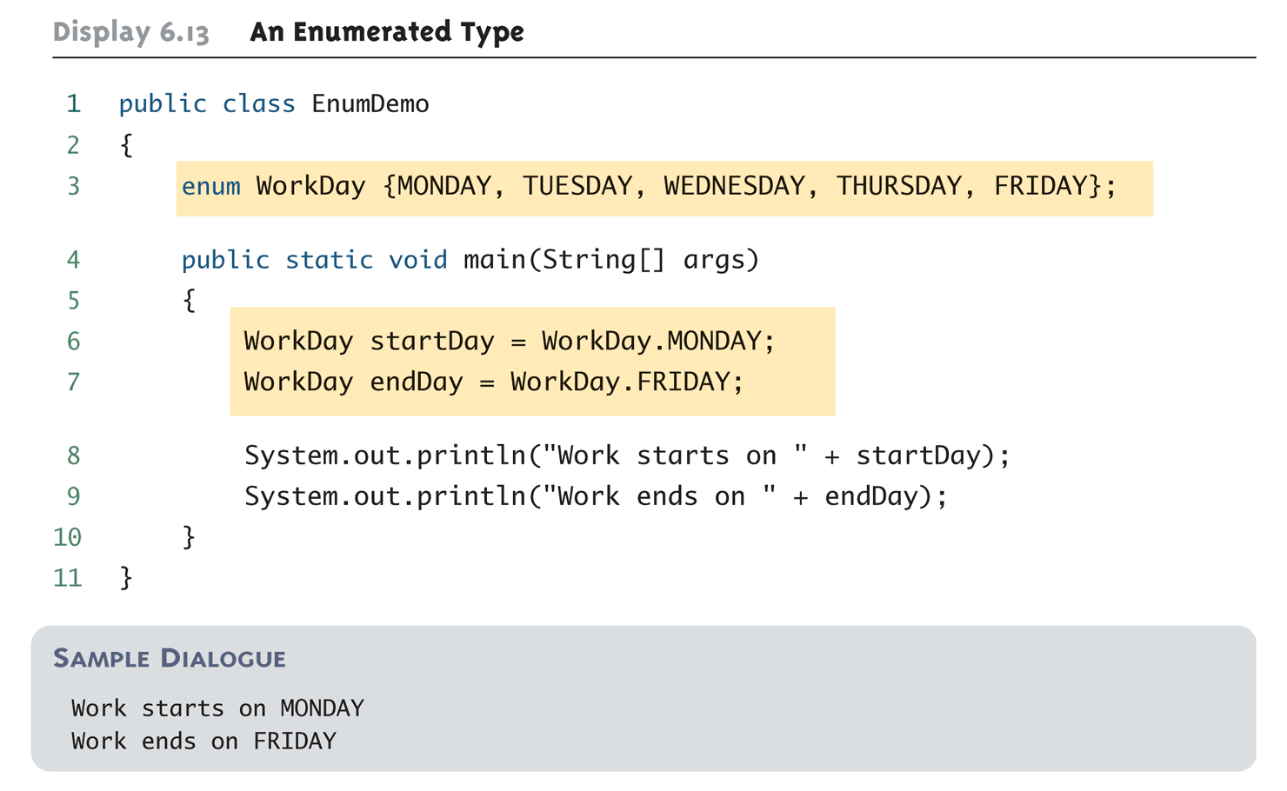
An Enumerated Type
Copyright © 2008 Pearson Addison-Wesley. All rights reserved
6-<number>

Slide 59
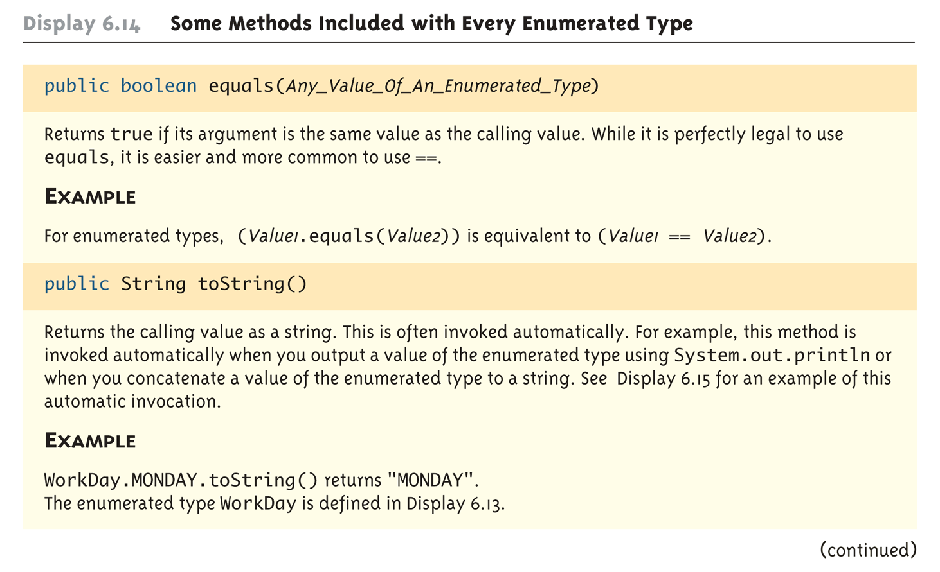
Some Methods Included with Every Enumerated Type (Part 1 of 3)
Copyright © 2008 Pearson Addison-Wesley. All rights reserved
6-<number>

Slide 60
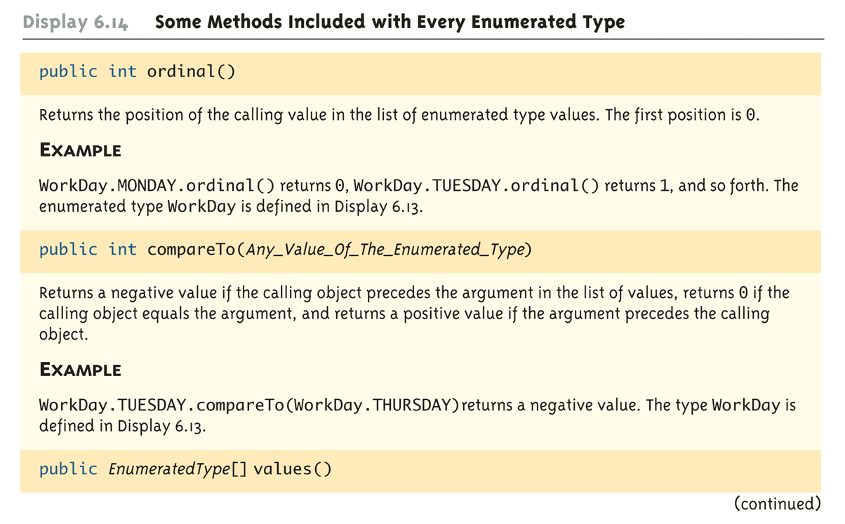
Some Methods Included with Every Enumerated Type (Part 2 of 3)
Copyright © 2008 Pearson Addison-Wesley. All rights reserved
6-<number>

Slide 61
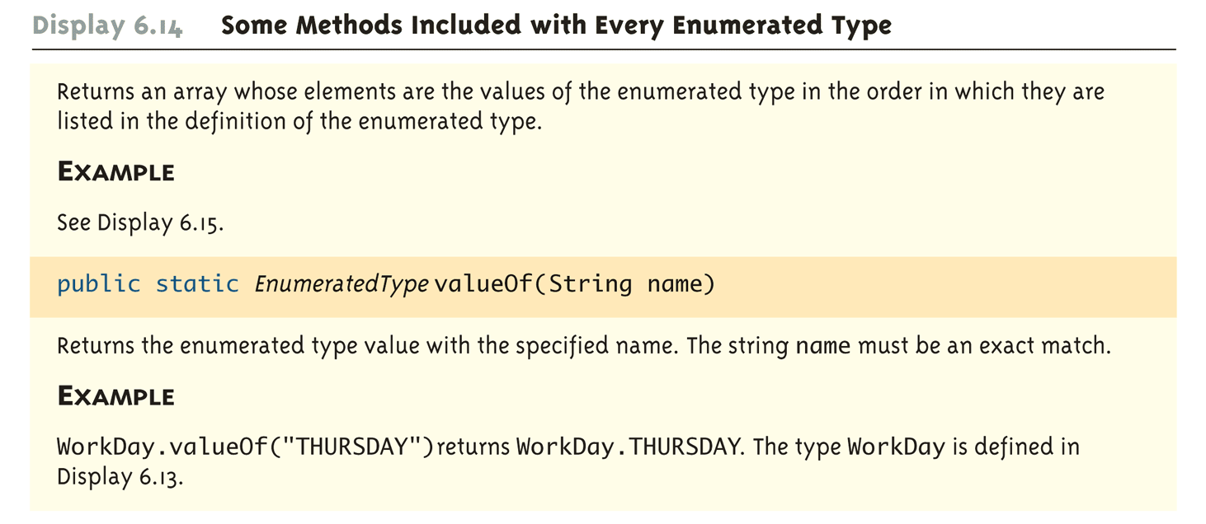
Some Methods Included with Every Enumerated Type (Part 3 of 3)
Copyright © 2008 Pearson Addison-Wesley. All rights reserved
6-<number>

Slide 62
The values Method
To get the full potential from an enumerated type, it is often necessary to cycle through all the values of the type
Every enumerated type is automatically provided with the static method values() which provides this ability
  It returns an array whose elements are the values of the enumerated type given in the order in which the elements are listed in the definition of the enumerated type
  The base type of the array that is returned is the enumerated type
Copyright © 2008 Pearson Addison-Wesley. All rights reserved
6-<number>

Slide 63
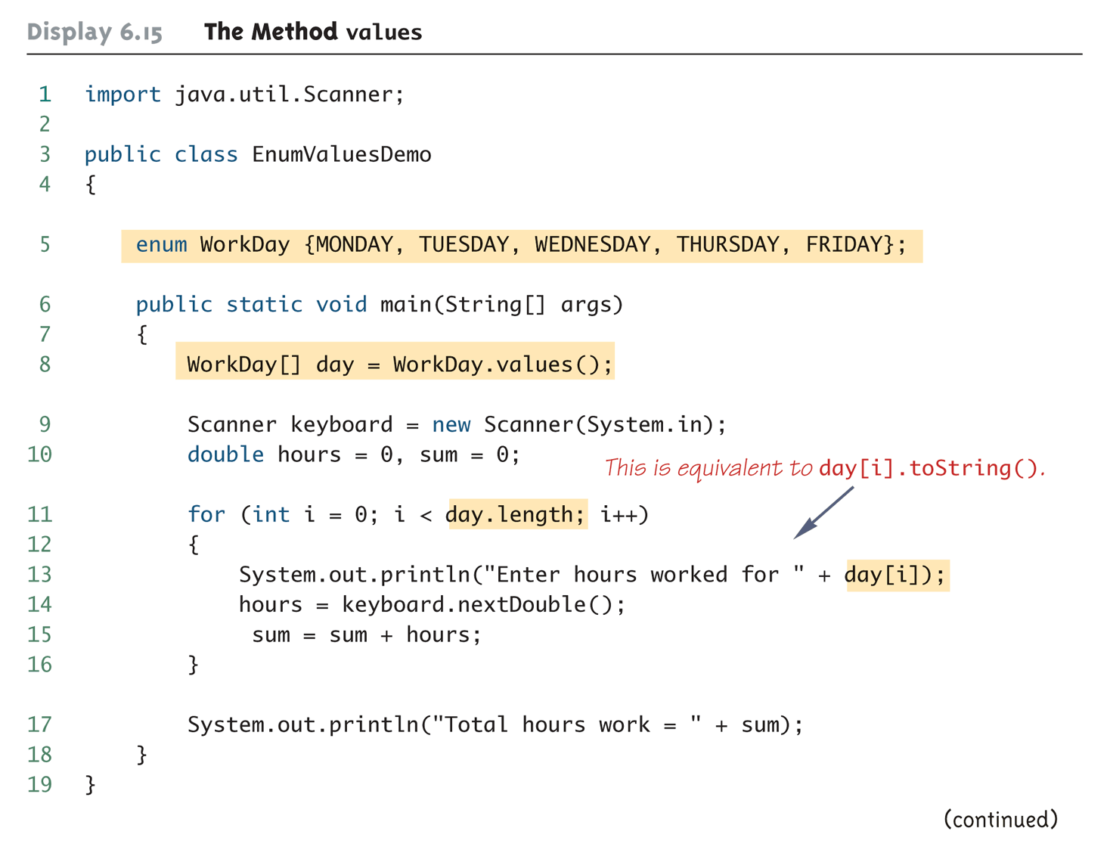
The Method values (Part 1 of 2)
Copyright © 2008 Pearson Addison-Wesley. All rights reserved
6-<number>

Slide 64
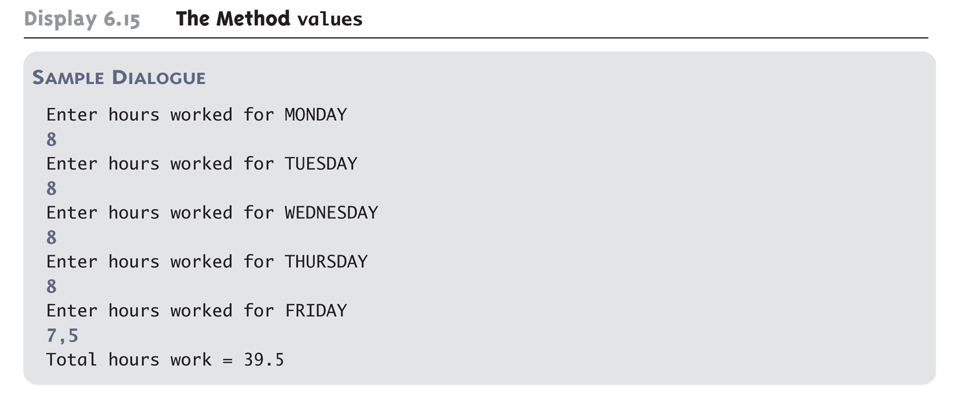
The Method values (Part 2 of 2)
Copyright © 2008 Pearson Addison-Wesley. All rights reserved
6-<number>

Slide 65
Programming Tip: Enumerated Types in switch Statements
Enumerated types can be used to control a switch statement
  The switch control expression uses a variable of an enumerated type
  Case labels are the unqualified values of the same enumerated type
The enumerated type control variable is set by using the static method valueOf to convert an input string to a value of the enumerated type
  The input string must contain all upper case letters, or be converted to all upper case letters using the toUpperCase method
Copyright © 2008 Pearson Addison-Wesley. All rights reserved
6-<number>

Slide 66
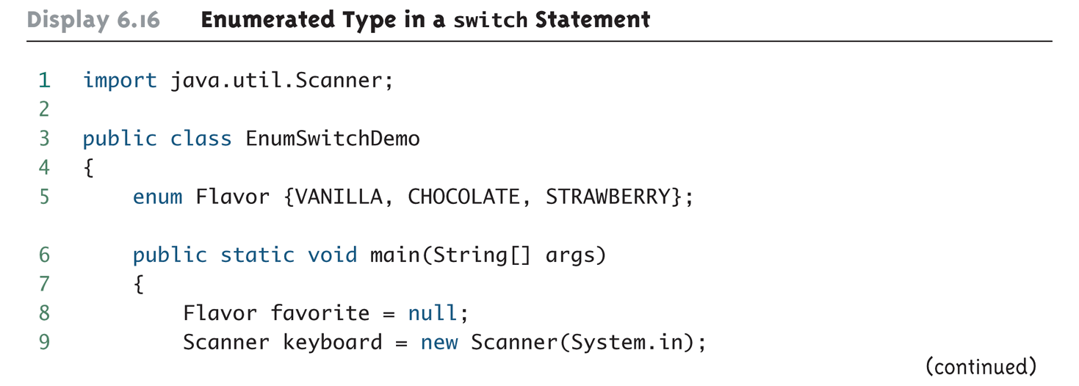
Enumerated Type in a switch Statement (Part 1 of 3)
Copyright © 2008 Pearson Addison-Wesley. All rights reserved
6-<number>

Slide 67
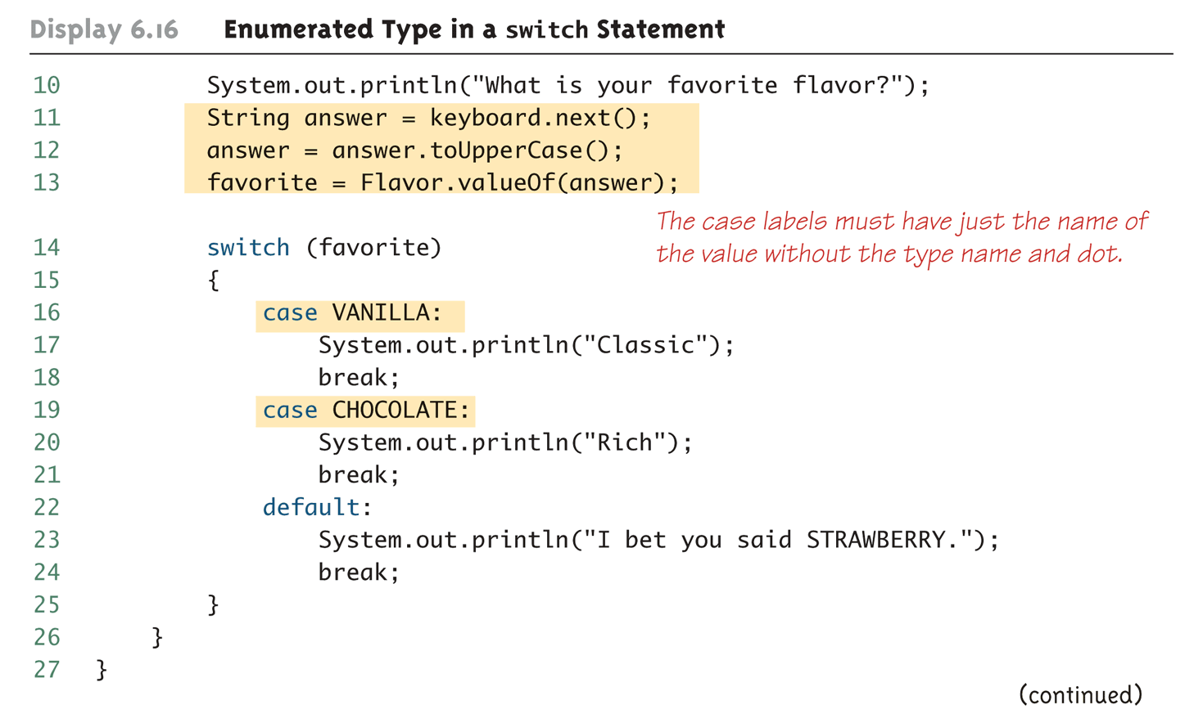
Enumerated Type in a switch Statement (Part 2 of 3)
Copyright © 2008 Pearson Addison-Wesley. All rights reserved
6-<number>

Slide 68
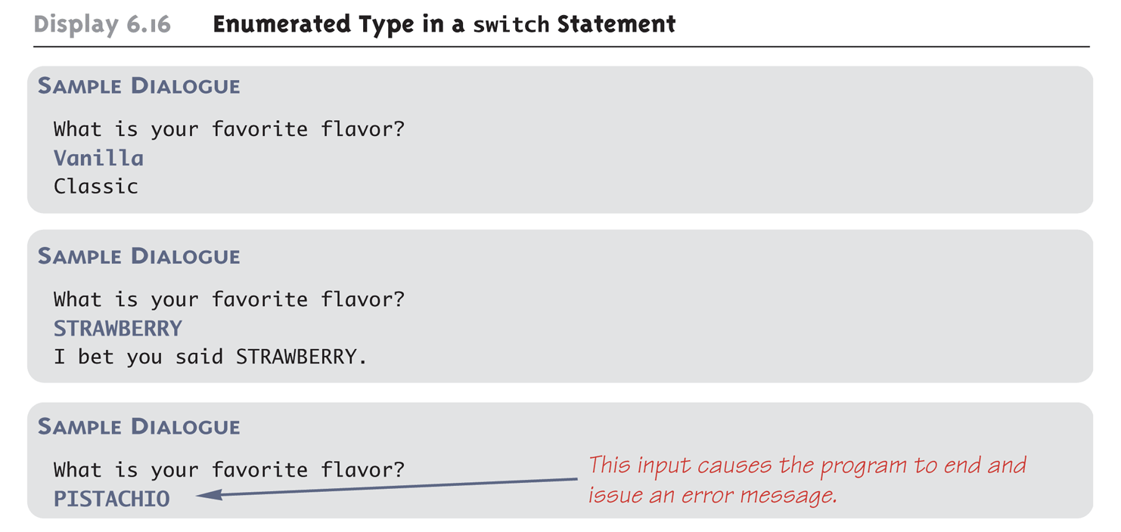
Enumerated Type in a switch Statement (Part 3 of 3)
Copyright © 2008 Pearson Addison-Wesley. All rights reserved
6-<number>

Slide 69
The following programs show the use of Method values and for each loop
ForEachEnumDemo
ForEachEnumDemo2
6-<number>

Slide 70
Multidimensional Arrays
It is sometimes useful to have an array with more than one index
Multidimensional arrays are declared and created in basically the same way as one-dimensional arrays
  You simply use as many square brackets as there are indices
  Each index must be enclosed in its own brackets
    double[][]table = new double[100][10];
    int[][][] figure = new int[10][20][30];
    Person[][] = new Person[10][100];
Copyright © 2008 Pearson Addison-Wesley. All rights reserved
6-<number>

Slide 71
One dimensional Array
double[] b = {42.0, 42.0, 42.0, 42.0, 42.0};
double[] b = new double[5];
for (int i = 0; i < b.length; i++)
b[i] = 42.0;
for (int i = 0; i < b.length; i++)
System.out.println( b[i]);
Copyright © 2008 Pearson Addison-Wesley. All rights reserved
6-<number>

Slide 72
Two dimensional Array
double[][] b = {{42.0, 42.0, 42.0, 42.0, 42.0},
{42.0, 42.0, 42.0, 42.0, 42.0},
{42.0, 42.0, 42.0, 42.0, 42.0} };
double[][] b = new double[3][5];
for (int i = 0; i < b.length; i++)
for (int j = 0; j < b[i].length; j++)
b[i][j] = 42;
Copyright © 2008 Pearson Addison-Wesley. All rights reserved
6-<number>

Slide 73
Two dimensional Array
for (int i = 0; i < b.length; i++)
{
for (int j = 0; j < b[i].length; j++)
{
System.out.println( b[i][j]);
}
}
Copyright © 2008 Pearson Addison-Wesley. All rights reserved
6-<number>

Slide 74
Ragged 2D Array
double[][] b = { {1, 3, 5},
{35, 26, 10, 5},
{42.0, 42.0} };
for (int i = 0; i < b.length; i++)
for (int j = 0; j < b[i].length; j++)
System.out.println( b[i][j] );
Copyright © 2008 Pearson Addison-Wesley. All rights reserved
6-<number>

Slide 75
Ragged 2D Array
    double [][] b;
    b = new double[3][];
    b[0] = new double[3];
    b[1] = new double[4];
    b[2] = new double[2];
    for (int i = 0; i < b.length; i++)
    for (int j = 0; j < b[i].length; j++)
    b[i][j] = 42;
Copyright © 2008 Pearson Addison-Wesley. All rights reserved
6-<number>

Slide 76
Multidimensional Arrays
Multidimensional arrays may have any number of indices, but perhaps the most common number is two
  Two-dimensional array can be visualized as a two-dimensional display with the first index giving the row, and the second index giving the column
    char[][] a = new char[5][12];
  Note that, like a one-dimensional array, each element of a multidimensional array is just a variable of the base type (in this case, char)
Copyright © 2008 Pearson Addison-Wesley. All rights reserved
6-<number>

Slide 77
Multidimensional Arrays
In Java, a two-dimensional array, such as a, is actually an array of arrays
  The array a contains a reference to a one-dimensional array of size 5 with a base type of char[]
  Each indexed variable (a[0], a[1], etc.) contains a reference to a one-dimensional array of size 12, also with a base type of char[]
A three-dimensional array is an array of arrays of arrays, and so forth for higher dimensions
Copyright © 2008 Pearson Addison-Wesley. All rights reserved
6-<number>

Slide 78
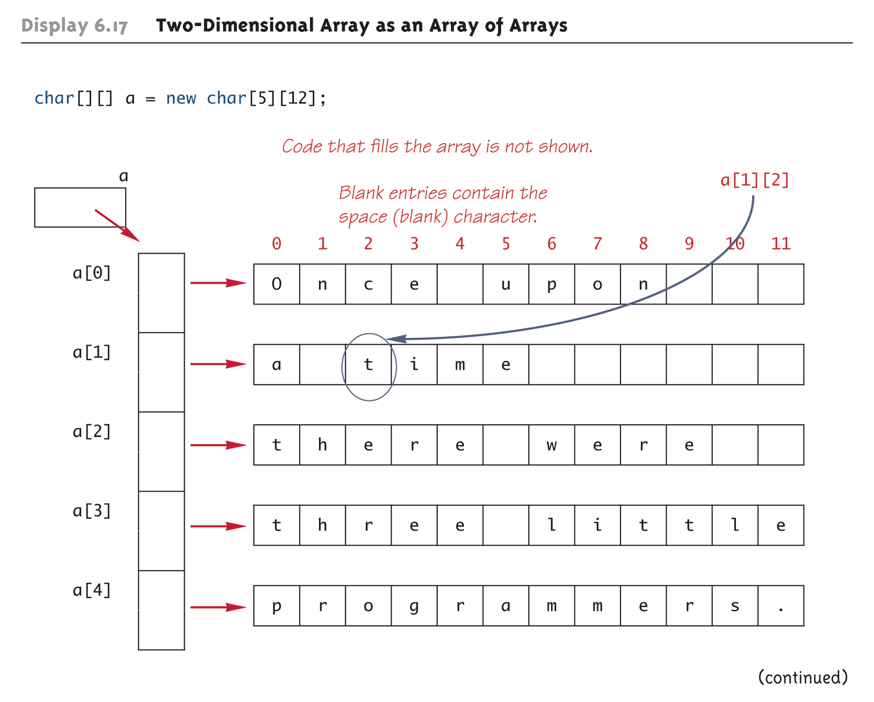
Two-Dimensional Array as an Array of Arrays (Part 1 of 2)
Copyright © 2008 Pearson Addison-Wesley. All rights reserved
6-<number>

Slide 79
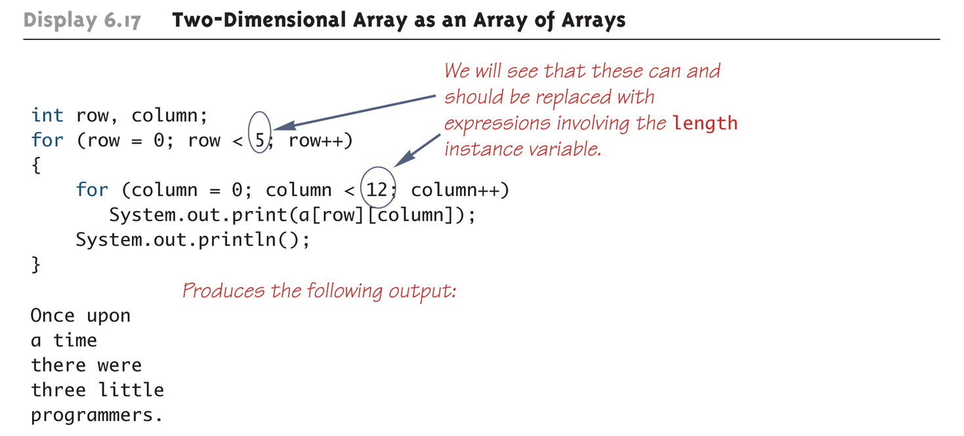
Two-Dimensional Array as an Array of Arrays (Part 2 of 2)
Copyright © 2008 Pearson Addison-Wesley. All rights reserved
6-<number>

Slide 80
Using the length Instance Variable
  char[][] page = new char[30][100];
The instance variable length does not give the total number of indexed variables in a two-dimensional array
  Because a two-dimensional array is actually an array of arrays, the instance variable length gives the number of first indices (or "rows") in the array
    page.length is equal to 30
  For the same reason, the number of second indices (or "columns") for a given "row" is given by referencing length for that "row" variable
    page[0].length is equal to 100
Copyright © 2008 Pearson Addison-Wesley. All rights reserved
6-<number>

Slide 81
Using the length Instance Variable
The following program demonstrates how a nested for loop can be used to process a two-dimensional array
  Note how each length instance variable is used
int row, column;
for (row = 0; row < page.length; row++)
for (column = 0; column < page[row].length;
column++)
page[row][column] = 'Z';
Copyright © 2008 Pearson Addison-Wesley. All rights reserved
6-<number>

Slide 82
Ragged Arrays
Each row in a two-dimensional array need not have the same number of elements
  Different rows can have different numbers of columns
An array that has a different number of elements per row it is called a ragged array
Copyright © 2008 Pearson Addison-Wesley. All rights reserved
6-<number>

Slide 83
Ragged Arrays
  double[][] a = new double[3][5];
The above line is equivalent to the following:
  double [][] a;
  a = new double[3][]; //Note below
  a[0] = new double[5];
  a[1] = new double[5];
  a[2] = new double[5];
  Note that the second line makes a the name of an array with room for 3 entries, each of which can be an array of doubles that can be of any length
  The next 3 lines each create an array of doubles of size 5
Copyright © 2008 Pearson Addison-Wesley. All rights reserved
6-<number>

Slide 84
Ragged Arrays
  double [][] a;
  a = new double[3][];
Since the above line does not specify the size of a[0], a[1], or a[2], each could be made a different size instead:
  a[0] = new double[5];
  a[1] = new double[10];
  a[2] = new double[4];
Copyright © 2008 Pearson Addison-Wesley. All rights reserved
6-<number>

Slide 85
Multidimensional Array Parameters and Returned Values
Methods may have multidimensional array parameters
  They are specified in a way similar to one-dimensional arrays
  They use the same number of sets of square brackets as they have dimensions
    public void myMethod(int[][] a)
    { . . . }
  The parameter a is a two-dimensional array
Copyright © 2008 Pearson Addison-Wesley. All rights reserved
6-<number>

Slide 86
Multidimensional Array Parameters and Returned Values
Methods may have a multidimensional array type as their return type
  They use the same kind of type specification as for a multidimensional array parameter
    public double[][] aMethod()
    { . . . }
  The method aMethod returns an array of double
Copyright © 2008 Pearson Addison-Wesley. All rights reserved
6-<number>

Slide 87
A Grade Book Class
As an example of using arrays in a program, a class GradeBook is used to process quiz scores
Objects of this class have three instance variables
  grade: a two-dimensional array that records the grade of each student on each quiz
  studentAverage: an array used to record the average quiz score for each student
  quizAverage: an array used to record the average score for each quiz
Copyright © 2008 Pearson Addison-Wesley. All rights reserved
6-<number>

Slide 88
A Grade Book Class
The score that student 1 received on quiz number 3 is recorded in grade[0][2]
The average quiz grade for student 2 is recorded in studentAverage[1]
The average score for quiz 3 is recorded in quizAverage[2]
Note the relationship between the three arrays
Copyright © 2008 Pearson Addison-Wesley. All rights reserved
6-<number>

Slide 89
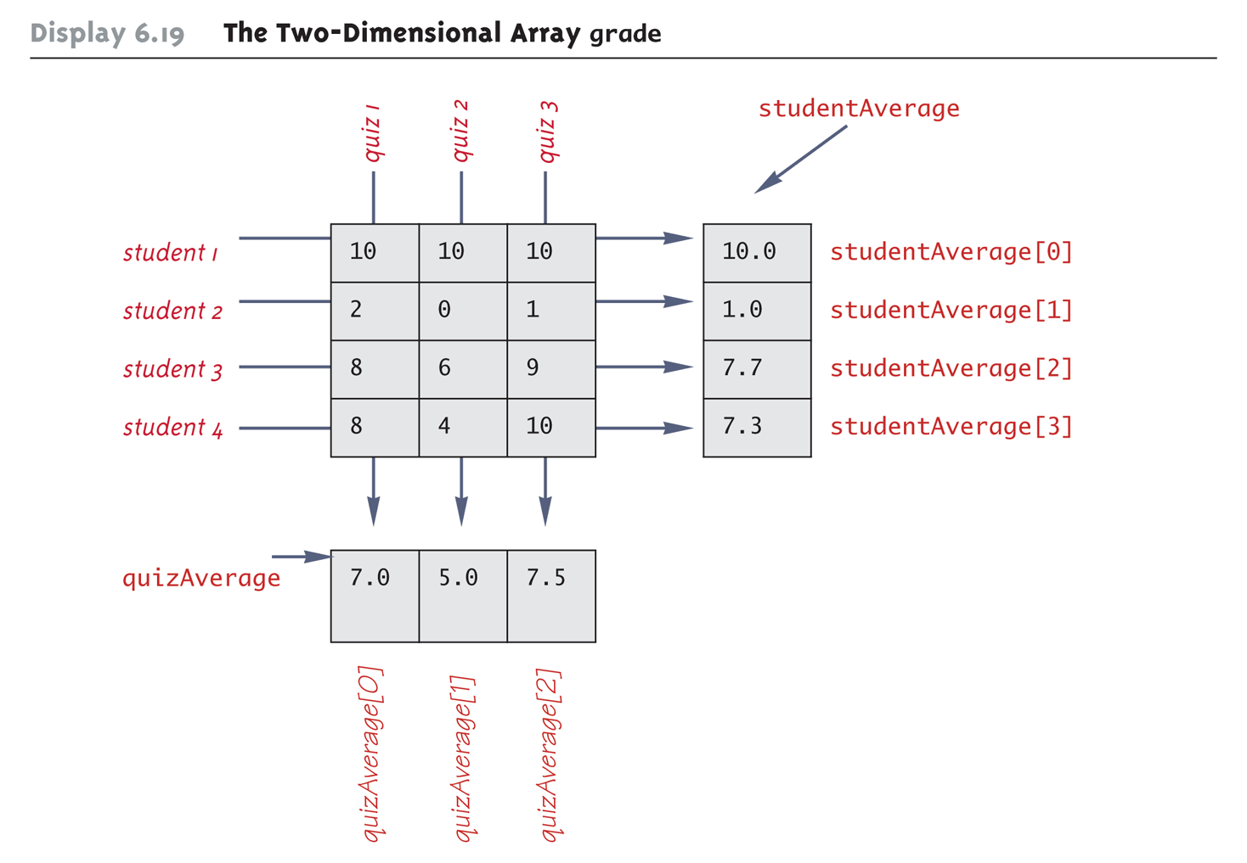
The Two-Dimensional Array grade
Copyright © 2008 Pearson Addison-Wesley. All rights reserved
6-<number>

Slide 90
Example of Two-Dimensional Array
GradeBook
GradeBookDemo
Copyright © 2008 Pearson Addison-Wesley. All rights reserved
6-<number>

Slide 91
public class GradeBook
{
private int numberOfStudents; // Same as studentAverage.length.
private int numberOfQuizzes; // Same as quizeAverage.length.
private int[][] grade; //numberOfStudents rows and numberOfQuizzes columns.
private double[] studentAverage;
private double[] quizAverage;
public GradeBook(int[][] a)
{
if (a.length == 0 || a[0].length == 0)
{
System.out.println("Empty grade records. Aborting.");
System.exit(0);
}
numberOfStudents = a.length;
numberOfQuizzes = a[0].length;
fillGrade(a);
fillStudentAverage( );
fillQuizAverage( );
}
5-<number>

Slide 92
public GradeBook(GradeBook book)
{
numberOfStudents = book.numberOfStudents;
numberOfQuizzes = book.numberOfQuizzes;
fillGrade(book.grade);
fillStudentAverage( );
fillQuizAverage( );
}
5-<number>

Slide 93
public GradeBook( )
{
Scanner keyboard = new Scanner(System.in);
System.out.println("Enter number of students:");
numberOfStudents = keyboard.nextInt( );
System.out.println("Enter number of quizzes:");
numberOfQuizzes = keyboard.nextInt( );
grade = new int [numberOfStudents][numberOfQuizzes];
5-<number>

Slide 94
for (int studentNumber = 1; studentNumber <= numberOfStudents; studentNumber++)
for (int quizNumber = 1; quizNumber <= numberOfQuizzes; quizNumber++)
{
System.out.println("Enter score for student number " + studentNumber);
System.out.println("on quiz number " + quizNumber);
grade[studentNumber - 1][quizNumber - 1] = keyboard.nextInt( );
}
fillStudentAverage( );
fillQuizAverage( );
}
5-<number>

Slide 95
private void fillGrade(int [][] a)
{
grade = new int[numberOfStudents][numberOfQuizzes];
for (int studentNumber = 1;
studentNumber <= numberOfStudents; studentNumber++)
{
for (int quizNumber = 1;
quizNumber <= numberOfQuizzes; quizNumber++)
grade[studentNumber-1][quizNumber-1] =
a[studentNumber-1][quizNumber-1];
}
}
Copyright © 2008 Pearson Addison-Wesley. All rights reserved
6-<number>

Slide 96
private void fillStudentAverage( )
{
studentAverage = new double[numberOfStudents];
for (int studentNumber = 1;
studentNumber <= numberOfStudents; studentNumber++)
{
double sum = 0;
for (int quizNumber = 1;
quizNumber <= numberOfQuizzes; quizNumber++)
sum = sum + grade[studentNumber - 1][quizNumber - 1];
studentAverage[studentNumber - 1] = sum / numberOfQuizzes;
}
}
Copyright © 2008 Pearson Addison-Wesley. All rights reserved
6-<number>

Slide 97
private void fillQuizAverage( )
{
quizAverage = new double[numberOfQuizzes];
for (int quizNumber = 1; quizNumber <= numberOfQuizzes; quizNumber++)
{
double sum = 0;
for (int studentNumber = 1;
studentNumber <= numberOfStudents; studentNumber++)
sum = sum + grade[studentNumber - 1][quizNumber - 1];
quizAverage[quizNumber - 1] = sum / numberOfStudents;
}
}
Copyright © 2008 Pearson Addison-Wesley. All rights reserved
6-<number>

Slide 98
public void display( )
{
for (int studentNumber = 1;
studentNumber <= numberOfStudents; studentNumber++)
{
System.out.print("Student " + studentNumber + " Quizzes: ");
for (int quizNumber = 1;
quizNumber <= numberOfQuizzes; quizNumber++)
System.out.print(grade[studentNumber - 1][quizNumber - 1] + " ");
System.out.println(" Ave = " + studentAverage[studentNumber - 1] );
}
System.out.println("Quiz averages: ");
for (int quizNumber = 1; quizNumber <= numberOfQuizzes; quizNumber++)
System.out.print("Quiz " + quizNumber
+ " Ave = " + quizAverage[quizNumber - 1] + " ");
System.out.println( );
}
}
Copyright © 2008 Pearson Addison-Wesley. All rights reserved
6-<number>

Slide 99
public class GradeBookDemo
{
public static void main(String[] args)
{
GradeBook book = new GradeBook( );
book.display( );
}
}
Copyright © 2008 Pearson Addison-Wesley. All rights reserved
6-<number>

